Slide 1
Concurrency on the JVM

Slide 2

OOP -> systems built using messages that are passed between biological cell-like objects that performed operations but did not hold any state.

Slide 3
Concurrency
Synchronized Deadlock
Wait
Notify
Race Conditions State
Volatile
Deadlock
Write Skew Anomaly
Locks Performance
Memory Barrier
Consistency issues Deadlock

Slide 4

… Disgusting

Slide 5
How should things be ?
- threads NOT competing to access mutable data ===> there is no issue of visibility or crossing the memory barrier.
- Real life : can’t avoid dealing with state, but we have three (3) options :
- Shared mutability
- Isolated mutability
- Pure immutability

Slide 6
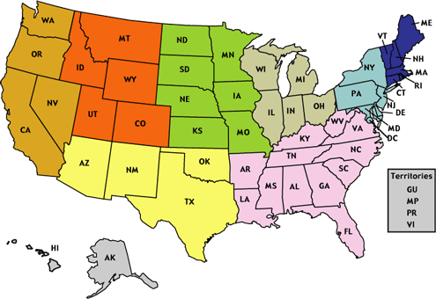
State ?
If you ask the same
question twice and get
different answers at
different times, you got
state.
But,
OOP ?
cell-like objects ?
NO state?

Slide 7


Slide 8
Obviously – OOP didn’t quite turn the way Alan Kay had in mind.
- state started to be combined with behavior
- started thinking that pieces of memory to which instances point contain data
Basically – identity and state were merged ! ☹
Identity -- > logical entity we associate with a series of related values over time

Slide 9
How about separating identity and state?
Would be nice huh ? ☺ To have immutable values and mutable identities.
Wait … mutable ?
But?
NO MUTABLE RIGHT?
OR … LIES ?
AGAIN ?

Slide 10
Introducing … STM – Software Transaction Memory
model popularized by Clojure
allows you to play it safe with shared mutability
enables TRUE concurrency since eliminates explicit synchronization
no more failing in crossing the memory barrier or race conditions
lock-free programming model

Slide 11
Separate identity and state by using Managed Transactional References (Refs)– managed mutable identity to an immutable value of type T.
Refs are bound to a single storage location for their lifetime, and only allow mutation of that location to occur within a transaction ( mutate to different immutable values ).
Transactions ?

Slide 12
YES !
ACID ?
Well … almost ==== > ACI transactions ( NO D – Durability since everything is in memory )
- start transaction = > STM notes timestamps and copies the Refs our transaction will use (inexpensive since the state is immutable ). These copies are held local to the transaction and if STM detects that the refs we’ve changed were modified, it aborts and RETRIES our transaction.
Idempotent !

Slide 13

Isn’t immutability expensive ?
Well, theoretically it is.
Except we can use Persistent Data Structures.
- smart data structures
When modifying a data
structure :
NEW VERSIONS ARE NOT
FULL COPIES !

Slide 14
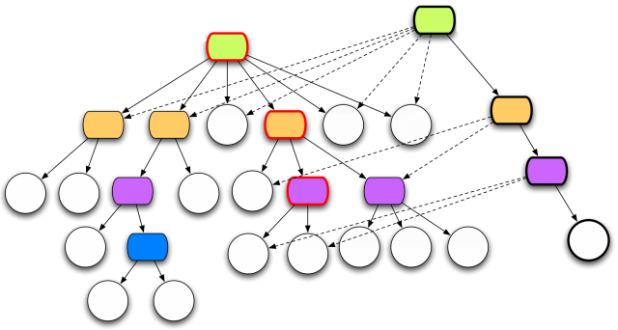
Structural sharing - new version will share substantial structure with the old version, using PATH COPYING.
Example used by Rich Hickey in his presentation :
Persistent Data Structures and Managed References: Clojure’s approach to Identity and State

Slide 15
STM in java ?
A couple of options :
Clojure STM
Multiverse
AKKA

Slide 16
AKKA
http://akka.io/
Written in Scala
API for Scala and Java
Platform to build correct concurrent and scalable applications
Provides a solution to implementing the Actor Programming Model ( => transparent distribution ) and STM
Actor + STM = TRANSACTORS ( … another talk, another time but it’s GREAT ! )

Slide 17
What’s the catch ?
Suitable only when write collisions are NOT frequent.
On a write collision : one transaction is successful, but the others are automatically retried => delay the execution of the colliding writers ( although it provide greater speed for readers and the winning writer )
For a high rate of write collision :
- best case - > slow writers
- worst case -> the writers will fail due to too many retries

Slide 18

GIMME` SOME CODE
The code is available on github :
https://github.com/andreidan/stmPlayground

Slide 19
Q & hopefully A

